Slide 1
DSP Lab. Week 6 Convolution
Kyuheon Kim
Media Lab. Rm567
kyuheonkim@khu.ac.kr
Last update : September 2, 2019

Slide 2

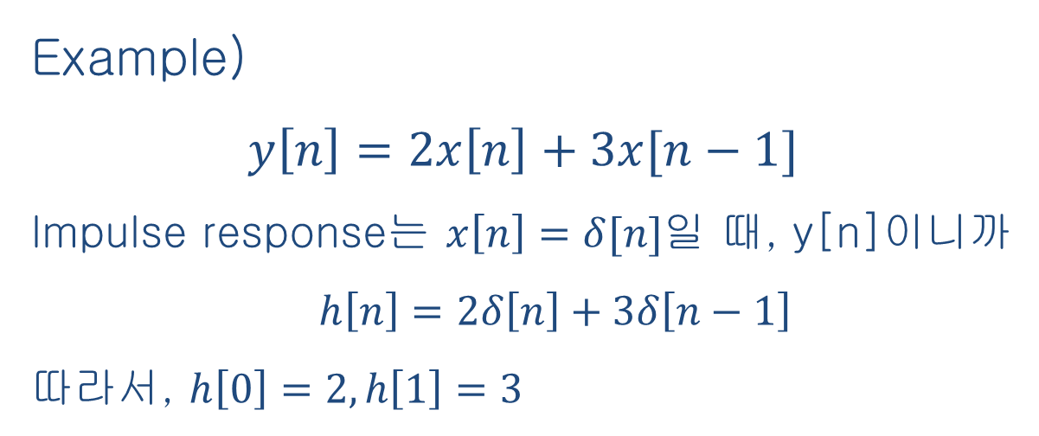
Convolution
Input signal
x[n]
impulse response
output signal
y[n]
h[n]

Slide 3
Convolution

Slide 4
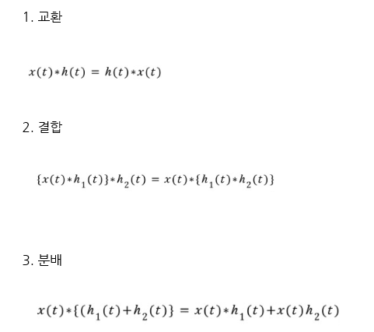
Convolution

Slide 5

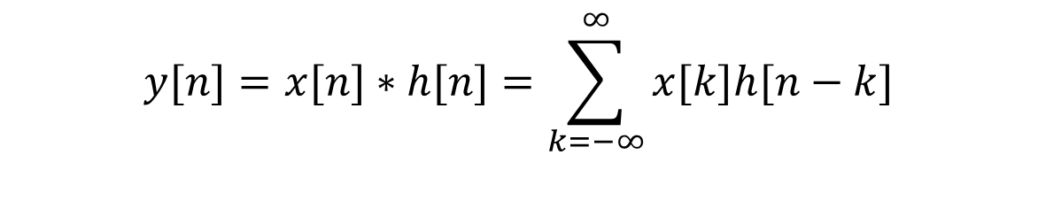







Convolution
$$y[n]=x[n]∗h[n]=\sum_{k=−∞}^{∞}{x[k]h[n−k]}$$
$$x[n]$$
$$h[n]$$
$$1$$
$$1$$
$$0$$
$$1$$
$$2$$
$$3$$
$$4$$
$$0$$
$$1$$
$$2$$

Slide 6
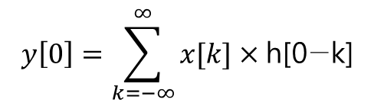


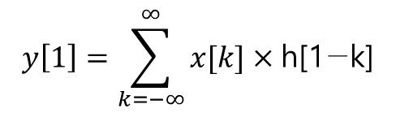
Convolution
1
1
-2
-1
0
1
2
3
4
n
0
1
2
3
4
n
$$y\left[0\right]=\sum_{k=−∞}^{∞}{x[k]×\text{h}\text{[0−}\text{k}\text{]}}$$
$$y\left[1\right]=\sum_{k=−∞}^{∞}{x[k]×\text{h}\text{[1−}\text{k}\text{]}}$$
$= y\left[0\right]=$ $x[0]×\text{h}\text{[0] = }1$
$= y\left[1\right]=$ $x[0]×\text{h}\text{[1] +}x[1]×\text{h}\text{[0] }$ = 2

Slide 7
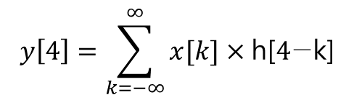

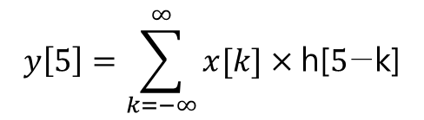
Convolution
1
1
0
1
2
3
4
n
0
1
2
3
4
n
$$y\left[4\right]=\sum_{k=−∞}^{∞}{x[k]×\text{h}\text{[}4\text{−}\text{k}\text{]}}$$
$$y\left[5\right]=\sum_{k=−∞}^{∞}{x[k]×\text{h}\text{[}5\text{−}\text{k}\text{]}}$$
1
1
$y\left[6\right]$, $y\left[7\right]$, $y\left[8\right]$
0
1
2
3
4
n
0
1
2
5
3
4
n

Slide 8












Convolution
$$x[n]$$
$$h[n]$$
$$1$$
$$1$$
$$∗$$
$$0$$
$$1$$
$$2$$
$$3$$
$$4$$
$$0$$
$$1$$
$$2$$
[ Result ]
$$y[n]$$
$$3$$
$$2$$
$$1$$
$$0$$
$$1$$
$$2$$
$$3$$
$$4$$
$$5$$
$$6$$

Slide 9
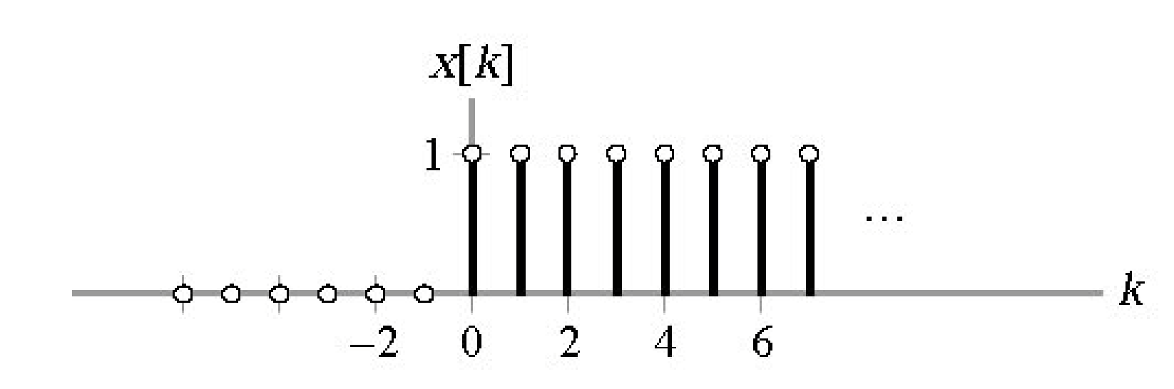
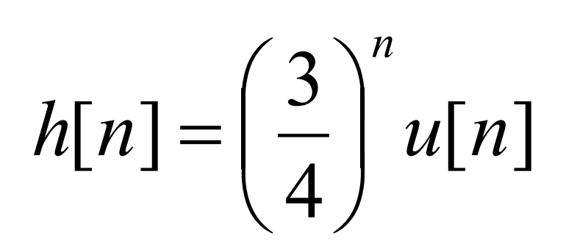
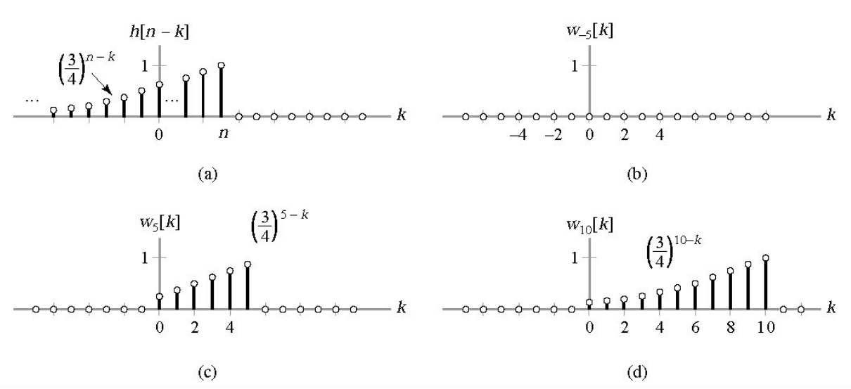

Convolution
$$∗$$

Slide 10
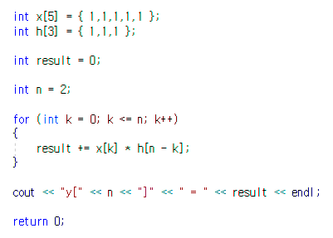

C++ Programming
[ Result ]

Slide 11
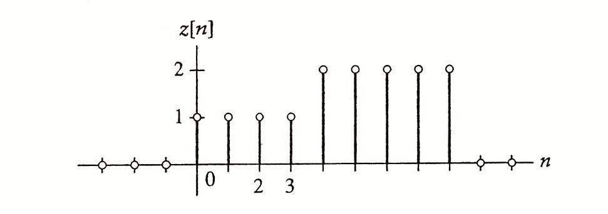
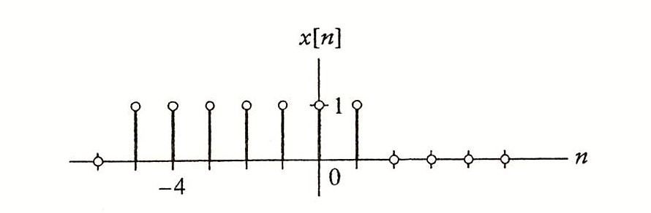
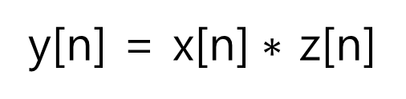
C++ Programming
y[n] = x[n]$∗$ z[n]
Draw y[n] using c++ programming and excel

Slide 12











Week 6 assignment
$$h_{2}[n]$$
$$x[n]$$
$$3$$
$$h_{1}[n]$$
$$1$$
$$1$$
$$2$$
$$1$$
$$0$$
$$1$$
$$2$$
$$3$$
$$4$$
$$0$$
$$6$$
$$0$$
$$1$$
$$2$$
$$3$$
$$4$$
$1. y\left[n\right] =x\left[n\right] ∗ h_{1}\left[n\right]$ $∗ h_{2}[n]$
$2. y\left[n\right]=cos($t)(u(t)-u(t-10)) $∗$ $e^{−t}$(u(t)-u(t-10))
y[n]을 c++ 프로그래밍을 통해 계산하고, 엑셀을 이용하여 그래프를 그려라

Slide 13
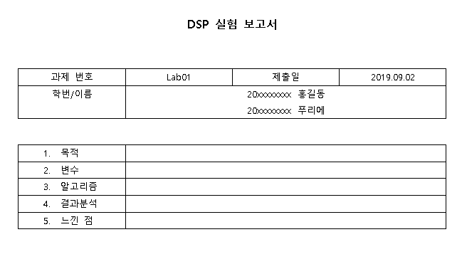

Week 6 assignment
“KLAS에 제출할 때 다음 사항을 꼭 지켜주세요”
파일명 : “Lab00_요일_대표자이름.zip”
Ex) Lab01_목_홍길동.zip (압축 툴은 자유롭게 사용)
2. 제출 파일 (보고서와 프로그램을 압축해서 제출)
- 보고서 파일 (hwp, word): 이름, 학번, 목적, 변수, 알고리즘(순서), 결과 분석, 느낀 점
- 프로그램
C++ 프로그램 파일
보고서
압축하여 제출

